Slide 1
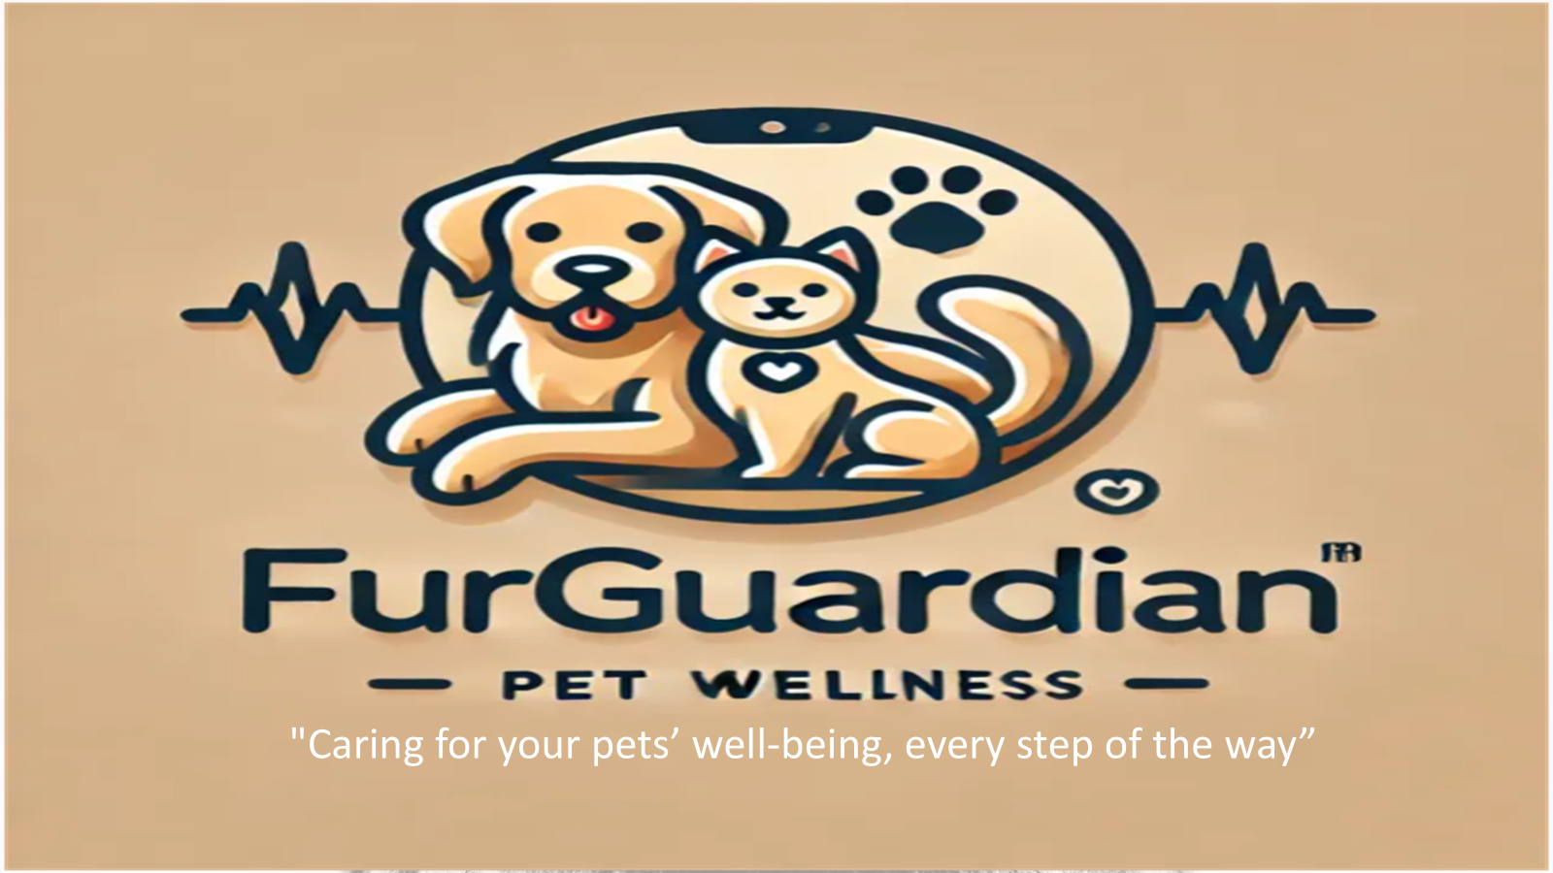

Slide 2
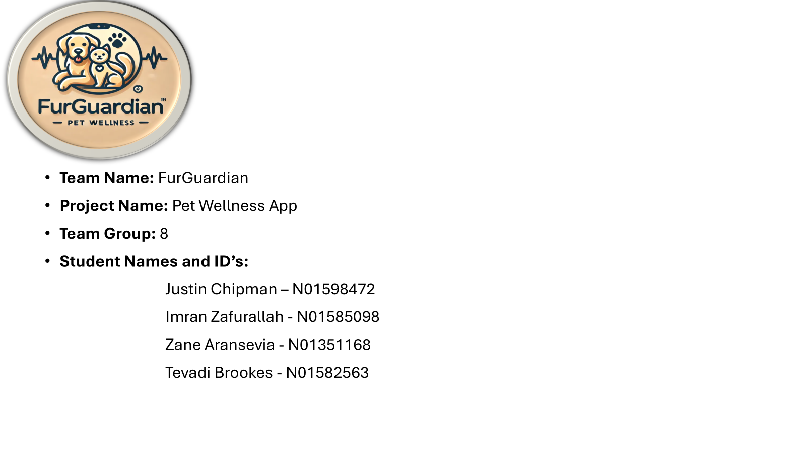

Slide 3
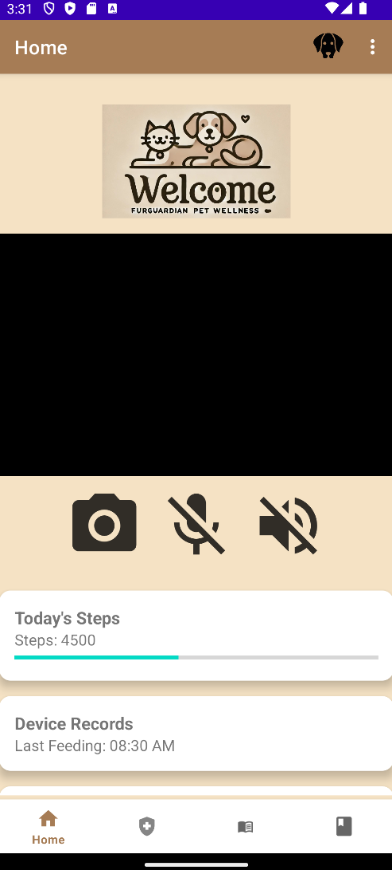
Main Components - Home Screen
Our product includes a camera feed providing real-time views of your pet during meal times or any activity, along with an integrated speaker and microphone for two-way communication. The home screen will showcase all available features for easy navigation.

Slide 4
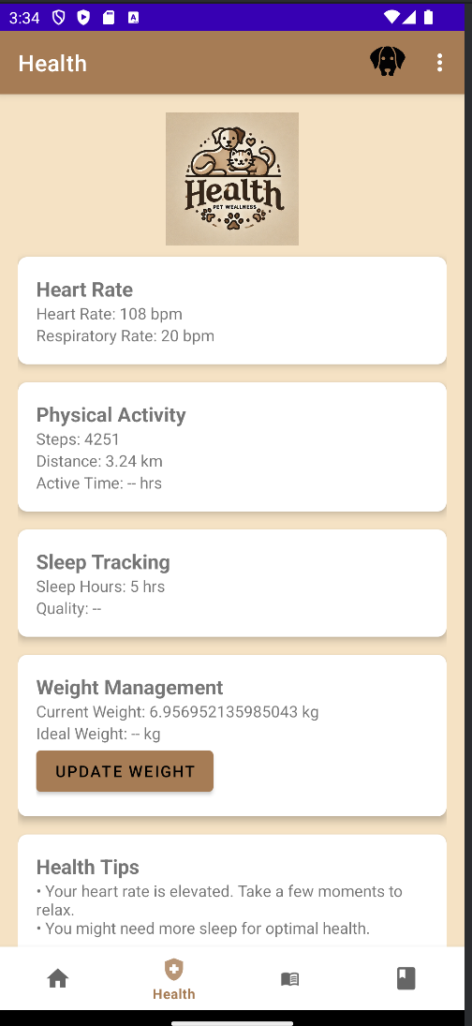
Main Components - Health
The Health screen will provide real-time data on your pet's vital statistics, including heart rate, step count, and sleep patterns. It will also feature health alerts, such as notifications for elevated heart rate or increased sleep duration, to help monitor your pet's well-being.

Slide 5
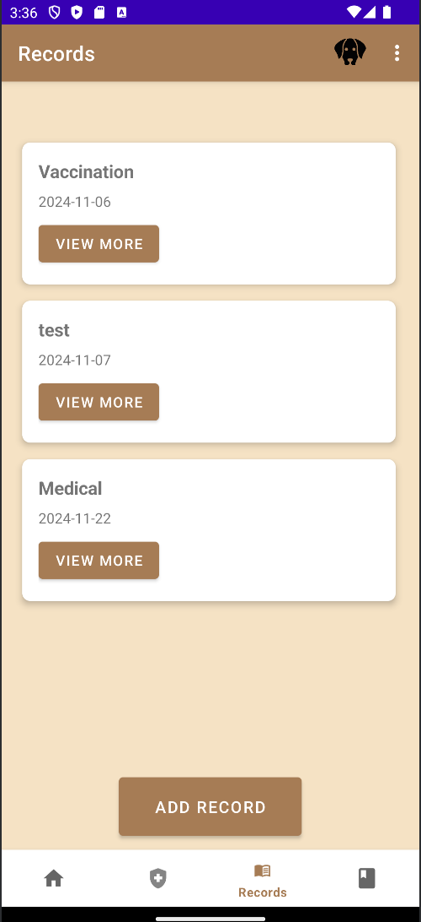
Main Components - Records
The Records screen stores past medical records organized by each pet's profile, allowing users to conveniently add or delete records as needed.

Slide 6
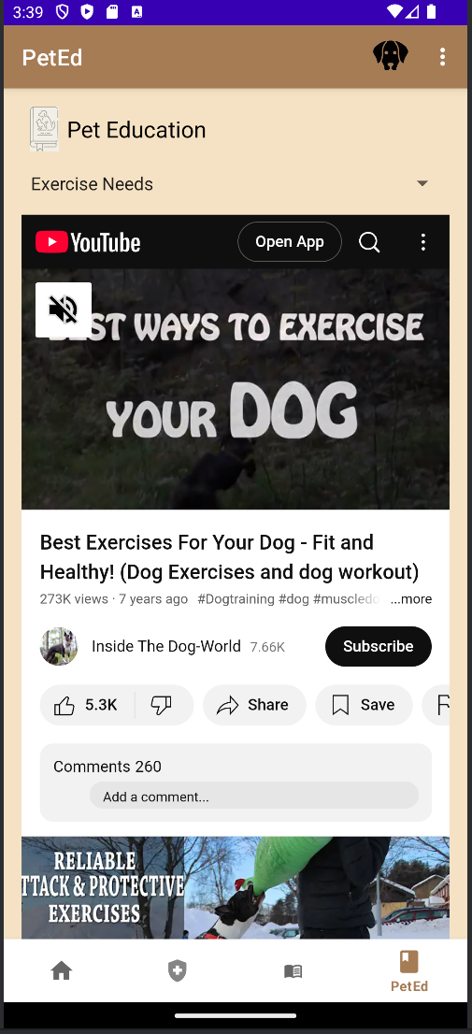
Main Components - Pet Education
The Education and Shopping screen provides resources for pet care and training, including access to grooming techniques, dog training tutorials, and exercise routines tailored to different breeds via integrated YouTube videos. Additionally, the screen allows users to conveniently purchase pet food, toys, and other essentials directly within the app.

Slide 7
Uniqueness of Our Pet Wellness App
Real-Time Metrics & Health Tips
Live health tracking: heart rate, steps, hydration.
Personalized health advice based on pet metrics.
Advanced Pet Profiles
Multi-pet support with custom images and details.
Persistent, customizable profiles for every pet.
Community Engagement
Active community relationships within the GTA.
Committed vendors on completion.
Comprehensive Records Management
Vet visits, medical history, and feeding schedules.
Expandable cards for detailed logs.
Interaction & Education
Simulated pet widget with voice interaction.
Training videos and educational links.
Future-Ready Features
IoT device connectivity (trackers, feeders).
Cloud backup and AI-powered health insights.

Slide 8
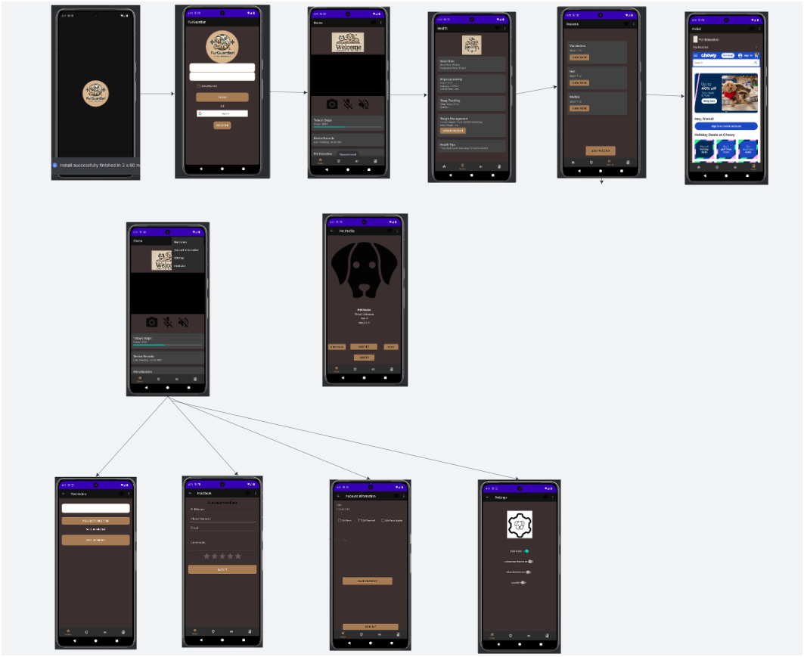
Screenflow

Slide 9
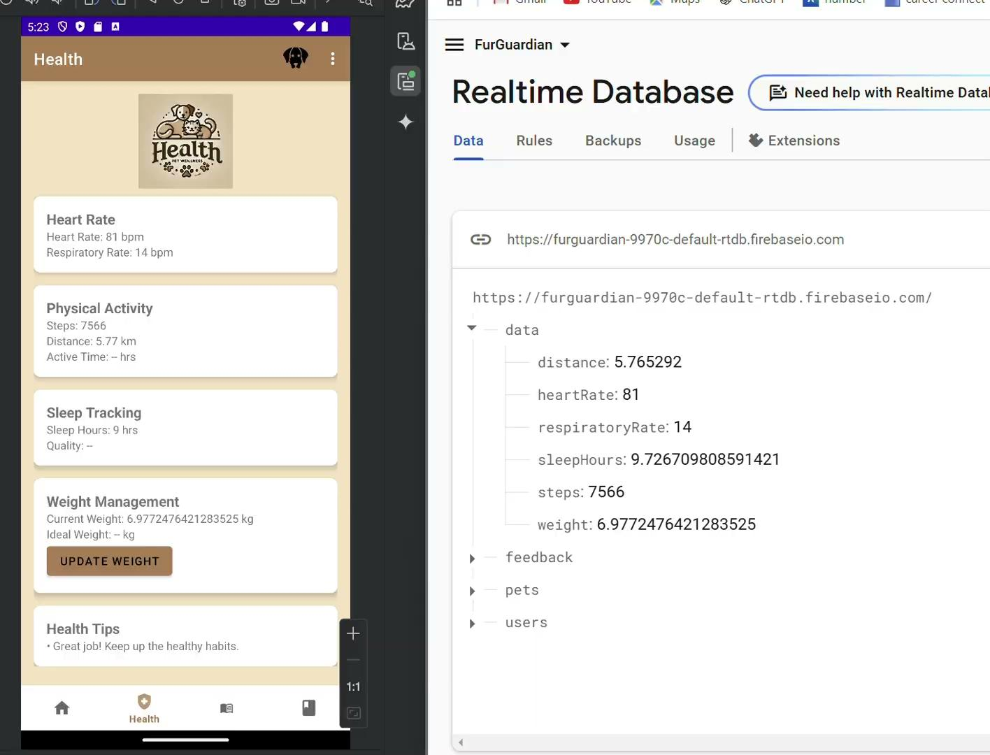
Database- Health Monitoring
The Database manages the storage of pet health data, ensuring real-time access and retrieval for seamless integration with the app's features whenever the data is required.

Slide 10
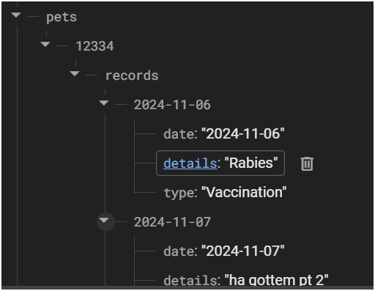
Database- Pet Records
This database stores pet medical records provided by veterinarians, enabling the app to retrieve and display the information whenever required.

Slide 11
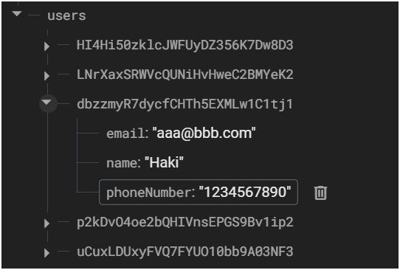
Database- Users
This database handles the storage and management of user login credentials and is responsible for validating user access to the app.

Slide 12
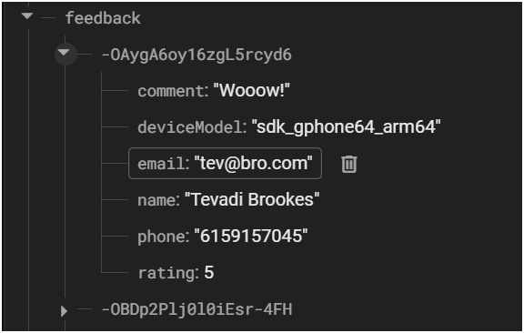
Database- Feedback
This database manages the storage of user feedback, including comments about the app, along with relevant user information for analysis and improvement purposes.

Slide 13
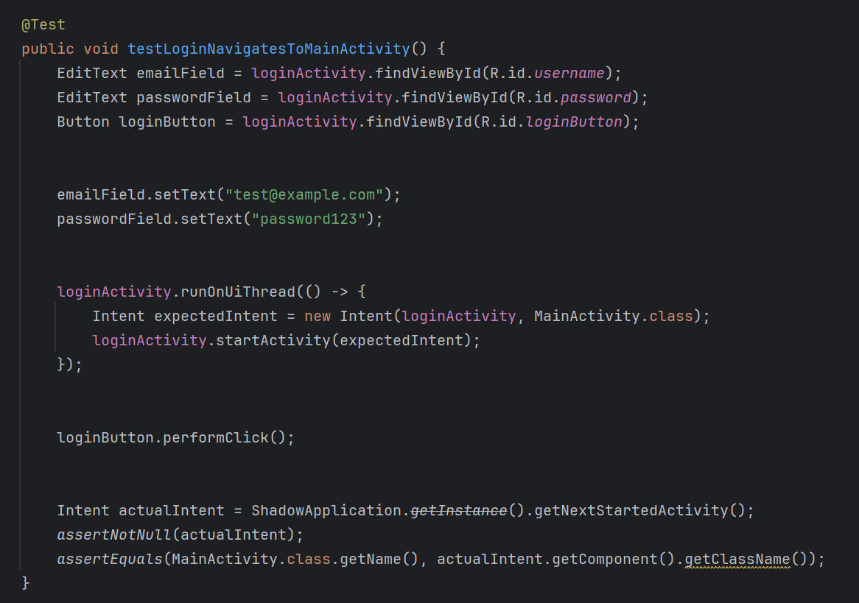
Testing the Pet Wellness App

Slide 14
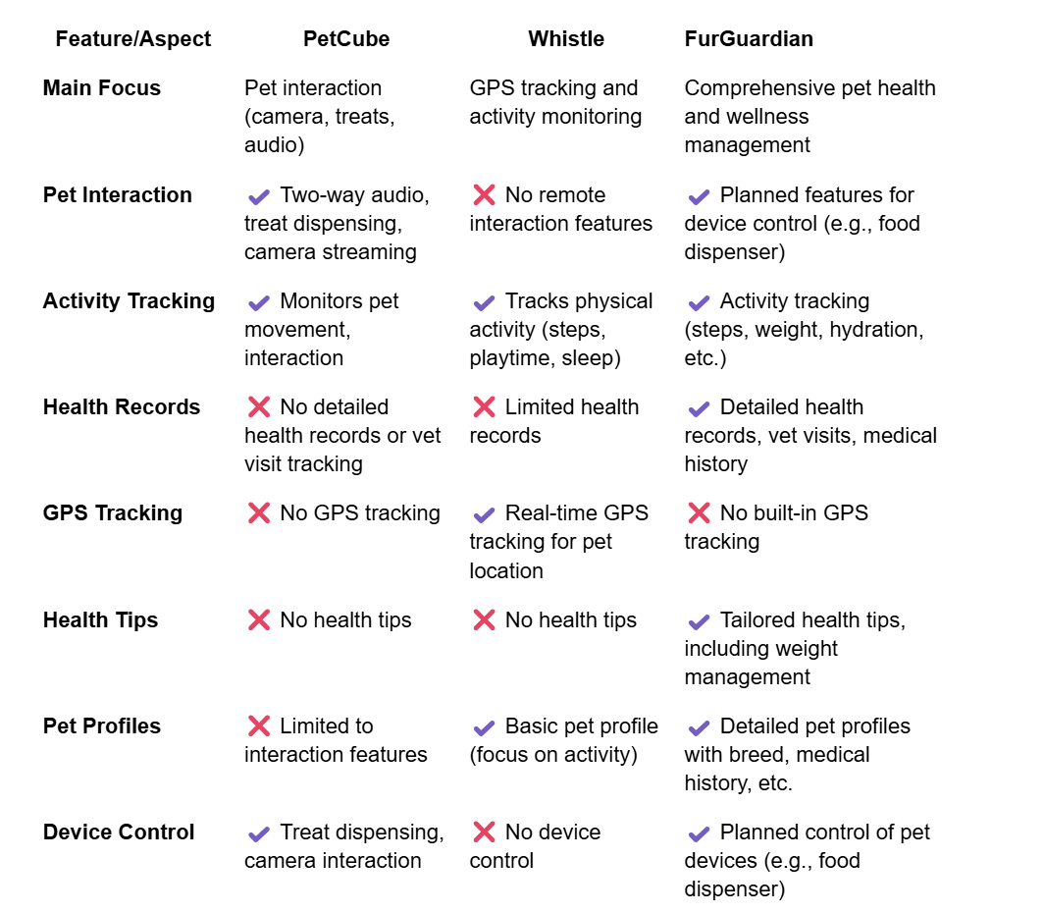
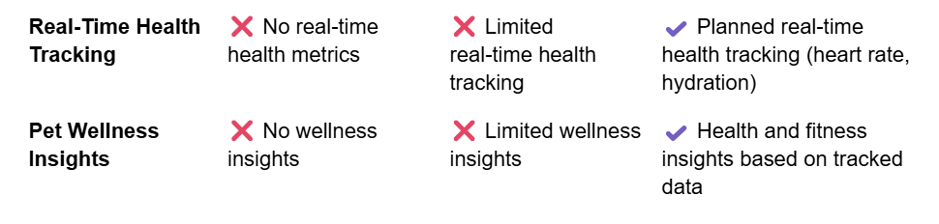
App Comparison

